Slide 1
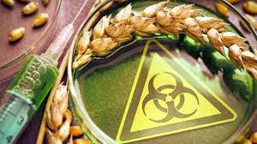
Opportunities and risks associated with genetic engineering
By Tabea Pyttlik

Slide 2
Table of Contents
What is genetic engineering
Opportunities and risks
Conclusion

Slide 3
What is genetic engineering?
Genetic engineering is a part of biotechnology
It deals with the isolation, characterization and recombination of genetic material
Genetic engineering is used in medicine, agriculture and industry

Slide 4
Risks
Genetically modified organisms are released into the environment
This can also manipulate other plants
Possible side effects have not been researched
Genetically modified corn has already caused damage to animals
Resistant pests can harm agriculture

Slide 5
Opportunities
Genetic engineering creates new opportunities in medicine
Genetic engineering of animal organs are suitable for transplantation into the human body
Pesticides can be saved in the long term
Genetically modified plants are stronger and survive climate change
Some researchers say that genetic manipulation is well under control

Slide 6

Conclusion
Genetic engineering has both opportunities and risks
Researchers disagree on many points
There are still not enough results to be sure what is right
However, genetic engineering already plays a role today and I think it will be also in the future

Slide 7
Sources
www.uni-bielefeld.de
www.lernhelfer.de
www.verbraucherzentrale.de

